Slide 1




FLYWEIGHT DESIGN PATTERN
Presented By : Omnia Sayed Hamed
Supervised By: Eng. Hany Safwat

Slide 2
AGENDA
Flyweight Design Pattern
1
Why do we care for number of objects in our program?
2
UML class diagram And Participants
3
Examples
4
Advantages of Flyweight Design pattern
5
Disadvantages of Flyweight Design pattern
6

Slide 3
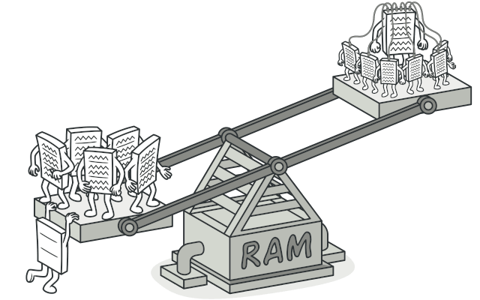
FLYWEIGHT DESIGN PATTERN
Flyweight pattern is one of the structural design patterns as this pattern provides ways to decrease object count thus improving application required objects structure. Flyweight pattern is used when we need to create a large number of similar objects (say 105). One important feature of flyweight objects is that they are immutable. This means that they cannot be modified once they have been constructed.

Slide 4
The Flyweight pattern distinguishes between the intrinsic and extrinsic state of an object. The greatest savings in the Flyweight pattern occur when objects use both kinds of state but:
1. Intrinsic state
2. Extrinsic state

Slide 5
INTRINSIC STATE : CAN BE SHARED ON A WIDE SCALE, MINIMIZING STORAGE REQUIREMENTS.
EXTRINSIC STATE : CAN BE COMPUTED ON THE FLY, TRADING COMPUTATION FOR STORAGE.
Notes:
Memory Usage: As you mentioned, fewer objects reduce memory usage. This is crucial, especially in memory-constrained environments or when dealing with large-scale applications where memory efficiency directly impacts performance.
Avoiding Memory Errors: With fewer objects, you decrease the likelihood of encountering memory-related errors such as Java's OutOfMemoryError. This error occurs when the Java Virtual Machine (JVM) runs out of memory to allocate new objects. By managing the number of objects carefully, you can mitigate the risk of such errors.
Performance Optimization: While object creation in Java is relatively fast, excessive object creation can still impact performance, particularly in time-sensitive applications or when dealing with a large number of objects. By reducing the number of objects and reusing them where possible, you can improve the overall execution time of your program. This optimization is not specific to Java; it applies to any programming language, including C#.
Resource Management: Objects often consume not just memory, but other resources as well, such as file handles or network connections. Managing the number of objects ensures efficient utilization of these resources and prevents resource exhaustion.
Garbage Collection Overhead: Although modern garbage collectors are highly efficient, they still incur overhead when reclaiming memory occupied by unused objects. By minimizing the number of objects, you reduce the frequency and duration of garbage collection cycles, which can contribute to better overall performance.
Maintainability and Readability: A well-designed program with a reasonable number of objects tends to be more maintainable and readable. Excessive object proliferation can lead to overly complex code, making it harder to understand, debug, and maintain.

Slide 6
WHY DO WE CARE FOR NUMBER OF OBJECTS IN OUR PROGRAM?
Memory Usage Reduction.
Avoiding Memory Errors.
Resource Management:
Garbage Collection Overhead Reduction.
Maintainability and Readability.
Notes:
Memory Usage: As you mentioned, fewer objects reduce memory usage. This is crucial, especially in memory-constrained environments or when dealing with large-scale applications where memory efficiency directly impacts performance.
Avoiding Memory Errors: With fewer objects, you decrease the likelihood of encountering memory-related errors such as Java's OutOfMemoryError. This error occurs when the Java Virtual Machine (JVM) runs out of memory to allocate new objects. By managing the number of objects carefully, you can mitigate the risk of such errors.
Performance Optimization: While object creation in Java is relatively fast, excessive object creation can still impact performance, particularly in time-sensitive applications or when dealing with a large number of objects. By reducing the number of objects and reusing them where possible, you can improve the overall execution time of your program. This optimization is not specific to Java; it applies to any programming language, including C#.
Resource Management: Objects often consume not just memory, but other resources as well, such as file handles or network connections. Managing the number of objects ensures efficient utilization of these resources and prevents resource exhaustion.
Garbage Collection Overhead: Although modern garbage collectors are highly efficient, they still incur overhead when reclaiming memory occupied by unused objects. By minimizing the number of objects, you reduce the frequency and duration of garbage collection cycles, which can contribute to better overall performance.
Maintainability and Readability: A well-designed program with a reasonable number of objects tends to be more maintainable and readable. Excessive object proliferation can lead to overly complex code, making it harder to understand, debug, and maintain.

Slide 7
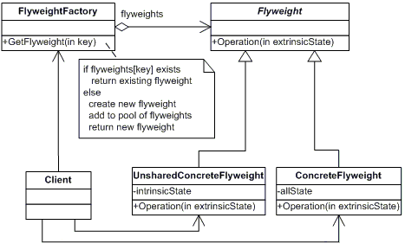
UML CLASS DIAGRAM
Notes:
Flyweight (Character)
declares an interface through which flyweights can receive and act on extrinsic state.
ConcreteFlyweight (CharacterA, CharacterB, ..., CharacterZ)
implements the Flyweight interface and adds storage for intrinsic state, if any. A ConcreteFlyweight object must be sharable. Any state it stores must be intrinsic, that is, it must be independent of the ConcreteFlyweight object's context.
UnsharedConcreteFlyweight ( not used )
not all Flyweight subclasses need to be shared. The Flyweight interface enables sharing, but it doesn't enforce it. It is common for UnsharedConcreteFlyweight objects to have ConcreteFlyweight objects as children at some level in the flyweight object structure (as the Row and Column classes have).
FlyweightFactory (CharacterFactory)
creates and manages flyweight objects
ensures that flyweight are shared properly. When a client requests a flyweight, the FlyweightFactory objects assets an existing instance or creates one, if none exists.
Client (FlyweightApp)
maintains a reference to flyweight(s).
computes or stores the extrinsic state of flyweight(s).

Slide 8
Participants
Flyweight (Character)
ConcreteFlyweight (CharacterA, CharacterB, ..., CharacterZ)
UnsharedConcreteFlyweight ( not used )
FlyweightFactory (CharacterFactory)
Client (FlyweightApp)
Notes:
Flyweight (Character)
declares an interface through which flyweights can receive and act on extrinsic state.
ConcreteFlyweight (CharacterA, CharacterB, ..., CharacterZ)
implements the Flyweight interface and adds storage for intrinsic state, if any. A ConcreteFlyweight object must be sharable. Any state it stores must be intrinsic, that is, it must be independent of the ConcreteFlyweight object's context.
UnsharedConcreteFlyweight ( not used )
not all Flyweight subclasses need to be shared. The Flyweight interface enables sharing, but it doesn't enforce it. It is common for UnsharedConcreteFlyweight objects to have ConcreteFlyweight objects as children at some level in the flyweight object structure (as the Row and Column classes have).
FlyweightFactory (CharacterFactory)
creates and manages flyweight objects
ensures that flyweight are shared properly. When a client requests a flyweight, the FlyweightFactory objects assets an existing instance or creates one, if none exists.
Client (FlyweightApp)
maintains a reference to flyweight(s).
computes or stores the extrinsic state of flyweight(s).

Slide 9
Example:-
1.Game Example
2.Real World Example
Lorna Alvarado

Slide 10
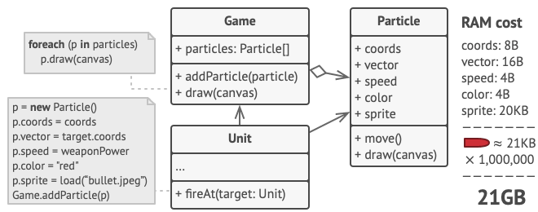
1.Game Example

Slide 11
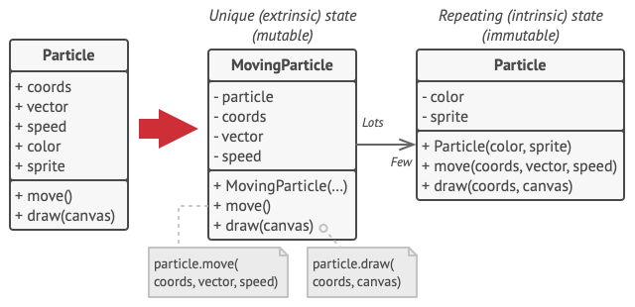
1.Game Example

Slide 12
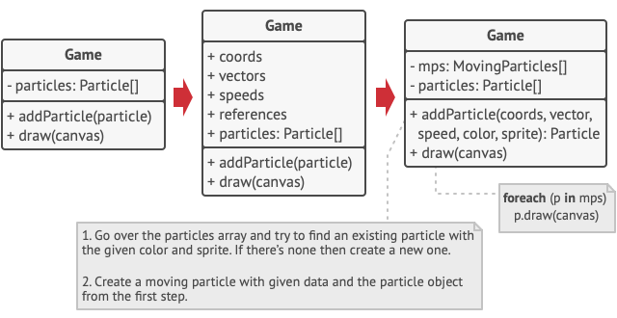
1.Game Example

Slide 13
The Flyweight Pattern contributes to improving the performance of the application by reducing the number of objects.
Advantages of Flyweight Design pattern
The Flyweight Pattern reduces the memory footprint and saving RAM as the common properties are shared between objects using Intrinsic properties.

Slide 14
If there are no shareable properties in an object, the pattern is of no use.
Disadvantages of Flyweight Design pattern
If memory is not a concern, implementing Flyweight design can be overkill for the application.
The pattern introduces code complexity.

Slide 15
SUMMARY
We try to learn about the Flyweight Design Pattern, a few scenarios where it can be applied along with its advantages and disadvantages, and also tried to implement the same with an example. The pattern really comes in handy in a situation where memory is a concern and the object of similar types need to created in large number.

Slide 16
REFERENCES:-
1.Book #C 3.0 Design Pattern
2.https://www.geeksforgeeks.org/flyweight-design-pattern/
3.https://refactoring.guru/design-patterns/flyweight
4.https://refactoring.guru/design-patterns/flyweight

Slide 17
THANK YOU

